Slide 1
Lecture 5
Convergence

Slide 2
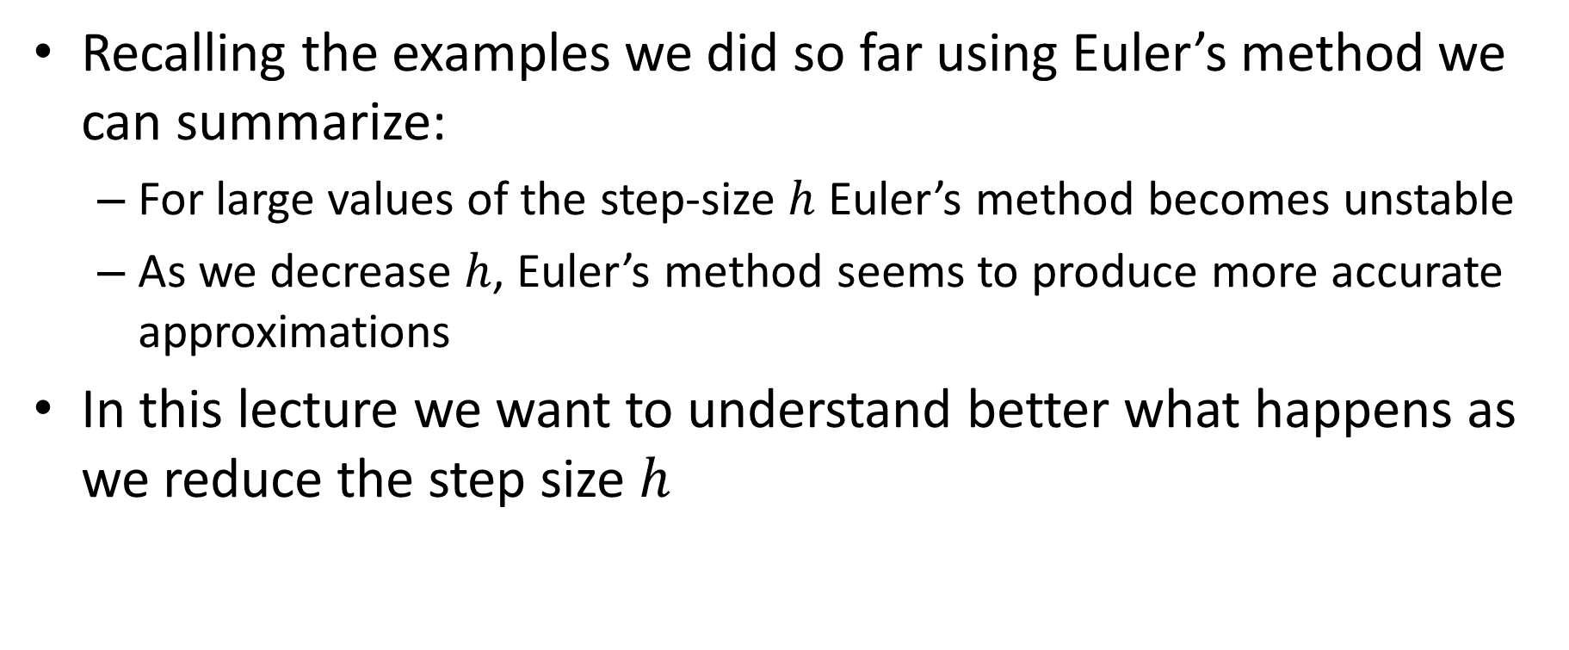
Introdction
Recalling the examples we did so far using Euler’s method we can summarize:
For large values of the step-size $h$ Euler’s method becomes unstable
As we decrease $h$, Euler’s method seems to produce more accurate approximations
In this lecture we want to understand better what happens as we reduce the step size $h$
Notes:
Let us recall the various examples we did so far using Euler's method.
As we did change our choice of the step size h we made two observations
First: for large values of the step-size, Euler’s method becomes unstable
Second: if we decrease the step-size the method seems to produce more accurate approximations
In this lecture we want to understand better what happens as we reduce the step size

Slide 3
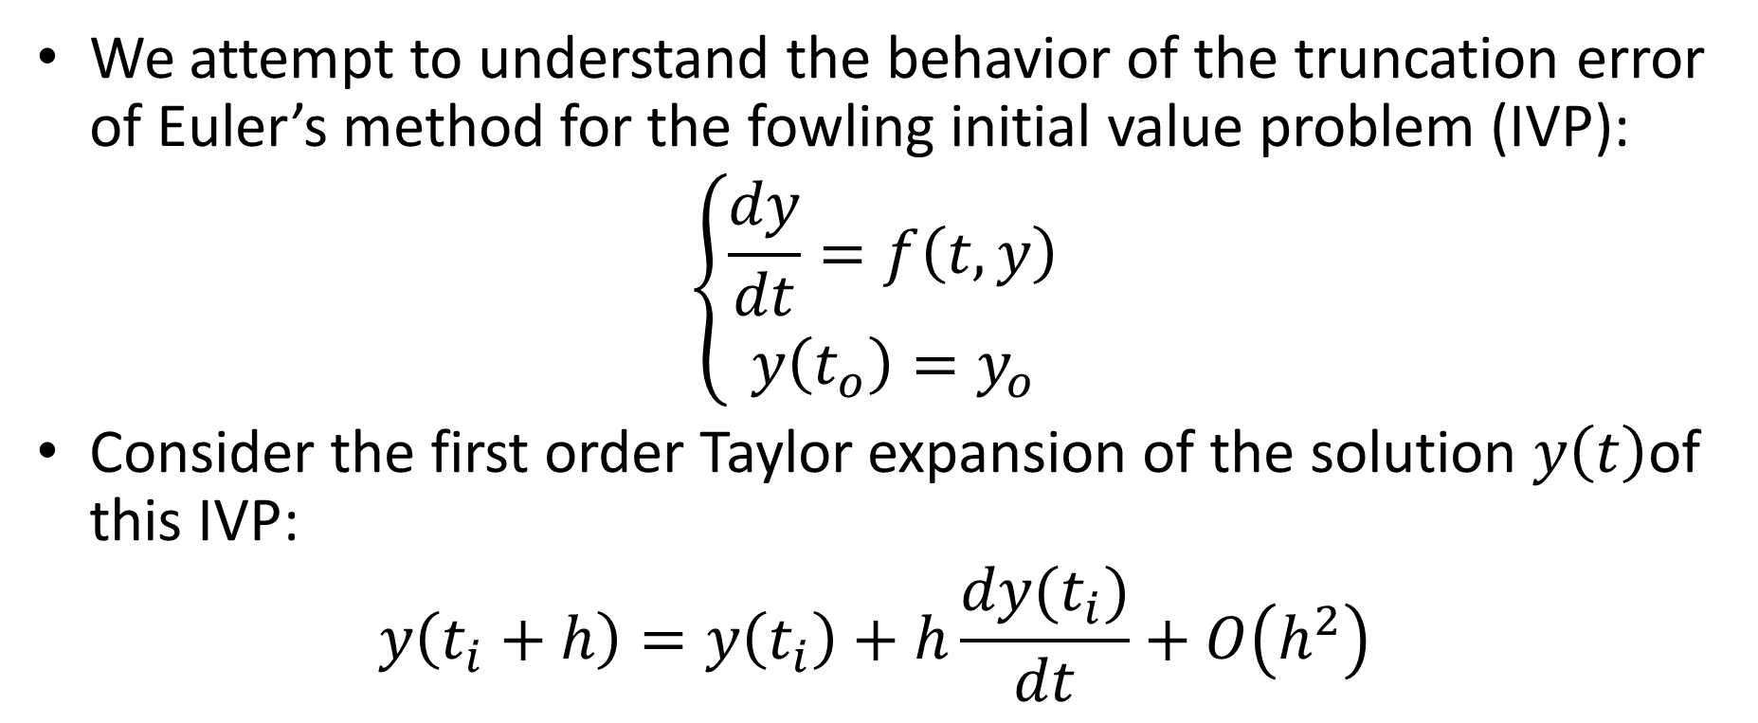
Truncation error
We attempt to understand the behavior of the truncation error of Euler’s method for the fowling initial value problem (IVP):
$$\left\{\begin{aligned}\frac{dy}{dt}=f\left(t,y\right) \\ y\left(t_{o}\right)=y_{o}\end{aligned}\right.$$
Consider the first order Taylor expansion of the solution $y\left(t\right)$of this IVP:
$$y\left(t_{i}+h\right)=y\left(t_{i}\right)+h\frac{dy(t_{i})}{dt}+O\left(h^{2}\right)$$
Notes:
Let us now attempt to understand the behavior of the truncation error of Euler’s method
We consider our usual initial value problem
If y(t) is the exact solution of this initial value problem, we can write the first order Taylor series expansion of y(ti+h) as
$$y\left(t_{i}+h\right)=y\left(t_{i}\right)+h\frac{dy(t_{i})}{dt}+O\left(h^{2}\right)$$

Slide 4
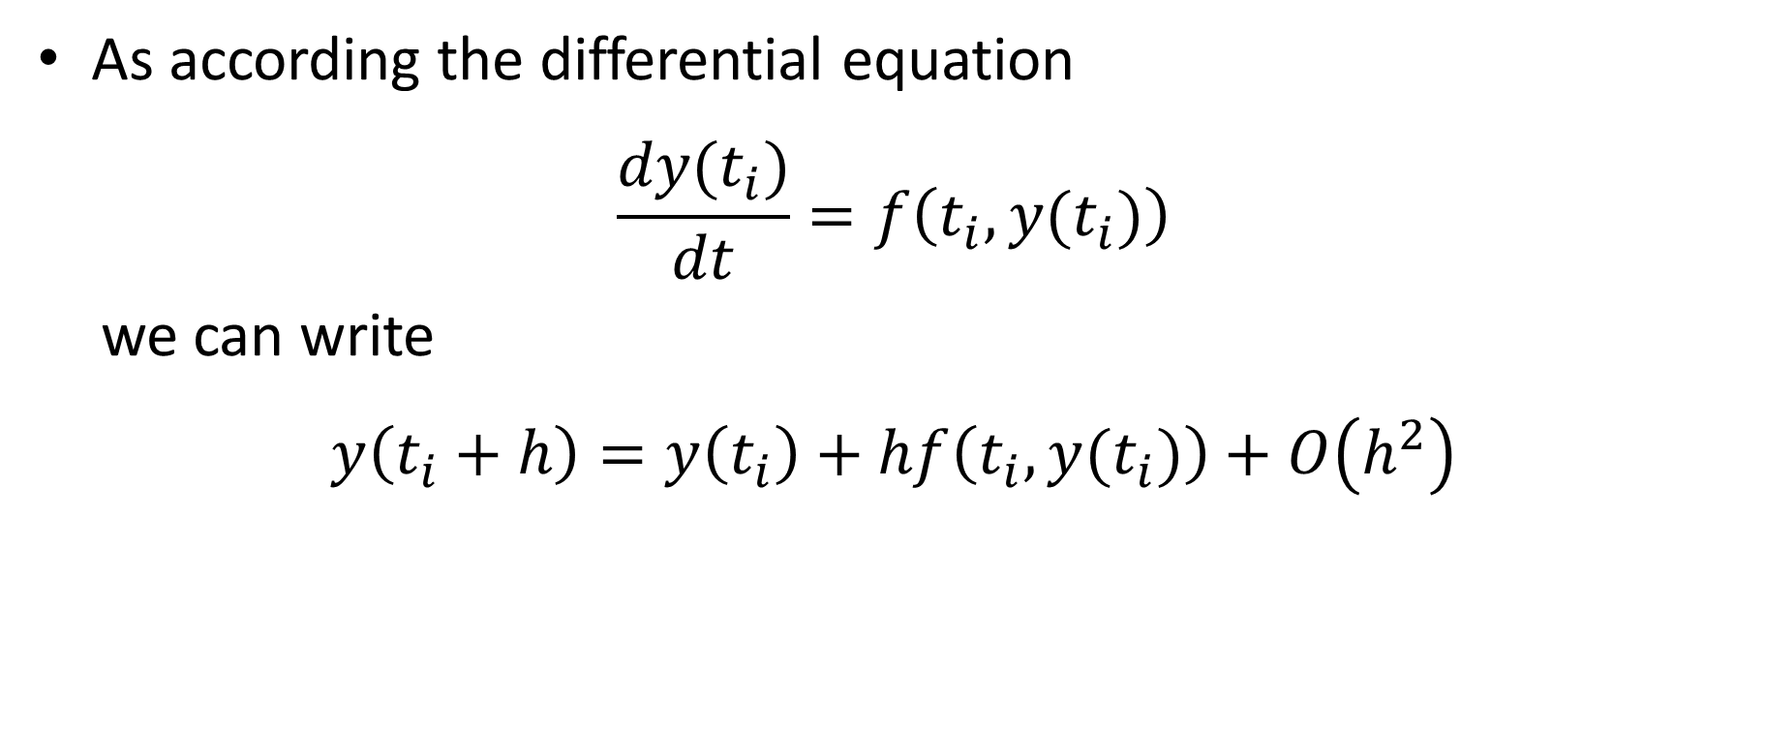
Truncation error
As according the differential equation
$$\frac{dy(t_{i})}{dt}=f\left(t_{i},y(t_{i})\right)$$
we can write
$$y\left(t_{i}+h\right)=y\left(t_{i}\right)+hf\left(t_{i},y(t_{i})\right)+O\left(h^{2}\right)$$
Truncation
error
Resembles Euler’s method
Notes:
Now, according the differential equation we have that $\frac{dy(t_{i})}{dt}=f\left(t_{i},y(t_{i})\right)$
Consequently we can write:
$$y\left(t_{i}+h\right)=y\left(t_{i}\right)+hf\left(t_{i},y(t_{i})\right)+O\left(h^{2}\right)$$
This expression has two parts
The first part looks very similar to Euler’s method
The last part would then be the truncation error.
According our calculations this truncation error is in second order in the step size h.

Slide 5
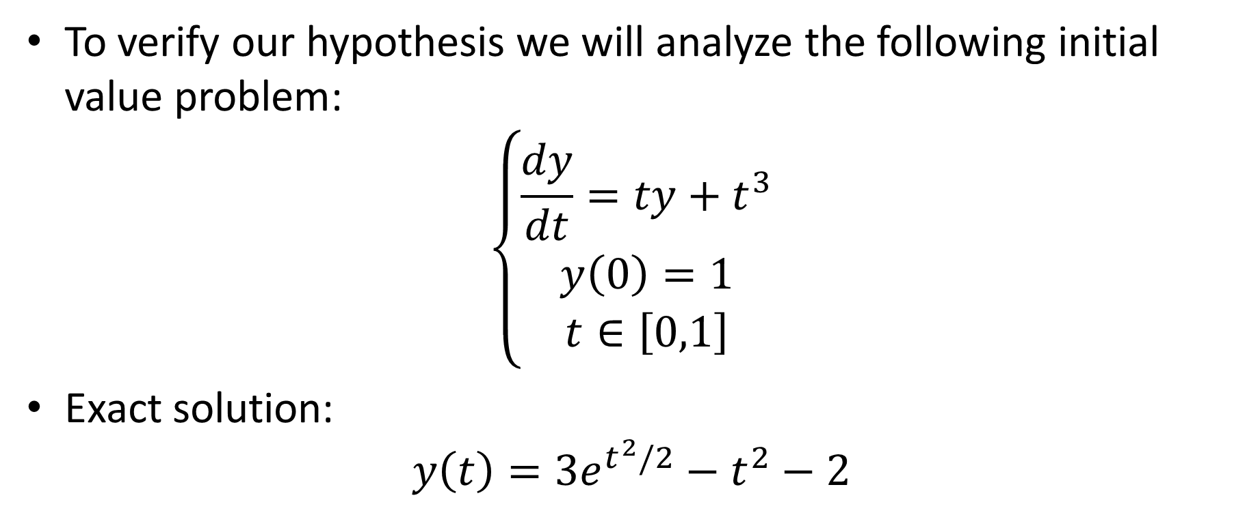
Illustration
To verify our hypothesis we will analyze the following initial value problem:
$$\left\{\begin{aligned}\frac{dy}{dt}=ty+t^{3} \\ y\left(0\right)=1 \\ t∈\left[0,1\right]\end{aligned}\right.$$
Exact solution:
$$y\left(t\right)={3e}^{t^{2}/2}−t^{2}−2$$
Notes:
Let us verify the hypothesis that the truncation error of Euler’s method is in second order in the step size
For this we solve with Euler’s method an initial value problem of know exact solution
The problem we consider is
$\frac{dy}{dt}=ty+t^{3}$
With initial condition y(0)=1
The exact solution of this problem is
$$y\left(t\right)={3e}^{t^{2}/2}−t^{2}−2$$
I invite you to verify by plugging this solution into the ODE that indeed it is the exact solution.
Verify as well that the initial value is satisfied

Slide 6
Octave Code
function [t, w] = euler(f,to,yo,h,n)
w=[yo];
t=[to];
for i = 1:n
w=[w w(end)+h*f(t(end),w(end))];
t=[t t(end)+h];
endfor
endfunction
>> f = @(t,y) t*y+t^3;
>> [t w]=euler(f, 0, 1, 1/3, 3);
>> t'
ans =
0.00000
0.33333
0.66667
1.00000
>> w’
ans =
1.0000
1.0000
1.1235
1.4719
Notes:
As we will solve the IVP for many different values of the step size h we write a small octave script to help us
For this we define a function euler.
This function will return tow vectors.
The vector t will contain the various ti and the vector w will contain the various wi
The function takes 4 arguments
The first one is the function f defining the ODE
The second one is the time to of the initial condition
The third is the corresponding initial value yo
The next argument is the step size h and the last argument is the number n of steps we want to perform
The function start by initializing the vectors w and t by filling them with the initial condition
These two vectors will then progressively be filled further with the calculated values ti and wi
We do this with a for loop running from 1 to n
Inside the loop we calculate the values wi and add them to the vector w
Note the keyword “end”. This keyword automatically sects the last entry of a vector
We compute as well the time steps ti and add them to the vector t
We close the for loop with the key word endfor and we close the function with the keyword endfunctio
Having defined this new function we can now use it to execute Euler’s method
For this we first enter the function f defining the ODE.
Note that have to respect the order of the arguments to be consistent with the way we use it in our function euler.
Once the function f is defined, the usage of euler is straight forward
We provide the various arguments which are the function f, the initial condition to=0 and yo=1
In this example we chose the step size h as equal to 1/3
We choose to perform n=3 steps
As expected the vector t runs from 0 to 1 with the step size h=1/3
The vector w contains the corresponding approximations wi computed by Euler’s algorithm
After finishing this lecture I invite you to try to code yourself your own function euler and play with it on some examples

Slide 7
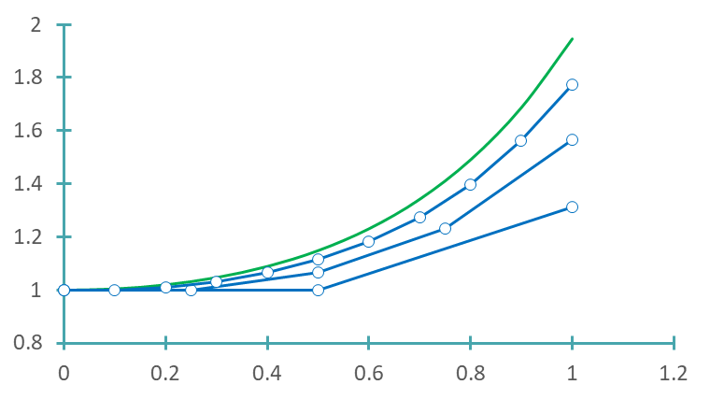


Numerical solutions
$$y$$
True solution
Truncation
error
$$t$$
Notes:
We can use our octave function euler to solve our IVP for different step sizes
The displayed graph shows some examples done with the step sizes 0.5, 0.25 and 0.2
The green continuous line is the exact solution
We can observe from the graph how, as the step size becomes smaller, the Euler approximations become closer and closer to the exact solution
We can as well observe how behaves the truncation error
For this we compute the difference between the Euler approximation provided in t=1 and the exact solution
Considering our graph we can already suspect that this truncation error doesn't seem to go down quadratically in the step size h, but rather only linearly.

Slide 8
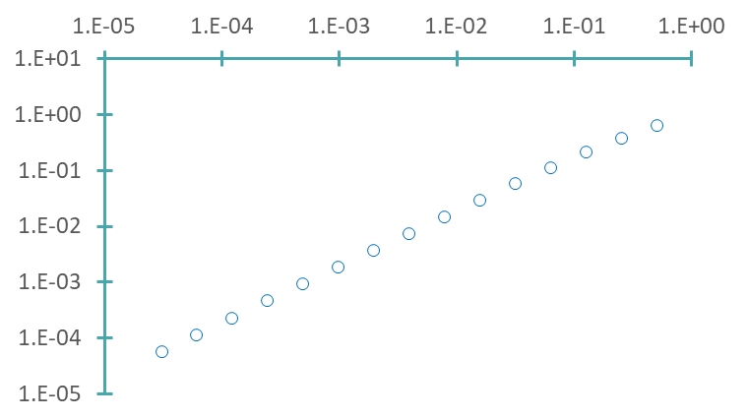




Convergence
$$h$$
$$E=O(h)$$
True Error$E$
$${E≅1.5h}^{0.974}$$
Notes:
A more careful analysis confirms our guess
If we plot the error in t=1 between the approximation provided by Euler’s method and the exact solition we observe indeed only a linear decrease in h and not a quadratic one
Fitting of a power law to the data confirms this statement
This result is surprising compared to our analysis we performed with the Taylor series expansion
What is even more surprising:
Euler’s method is indeed only linearly convergent, as we will learn in coming lectures
But more surprisingly we didn’t really do an error in our Taylor series analysis
As we will learn in coming lectures the mistake we are doing at this stage is how we use the conclusion form the Taylor series analysis
For the moment, the take away is
First: Euler’s method is providing better approximations as we reduce the step size
The error is decreasing linearly in the step size
And second: we have to be careful how we use the Taylor series analysis as we do something wrong. The coming lectures will clarify and explain what we are doing wrong

Slide 9

Summary
The numerical approximation produced by Euler’s method becomes more precise with smaller values of the step size $h$
The truncation error of Euler’s method is in first order in the step size $h$
Notes:
Let us summarize the key findings
The numerical approximation produced by Euler’s method becomes more precise with smaller values of the step size $h$
The truncation error of Euler’s method is in first order in the step size $h$

